Slide 1

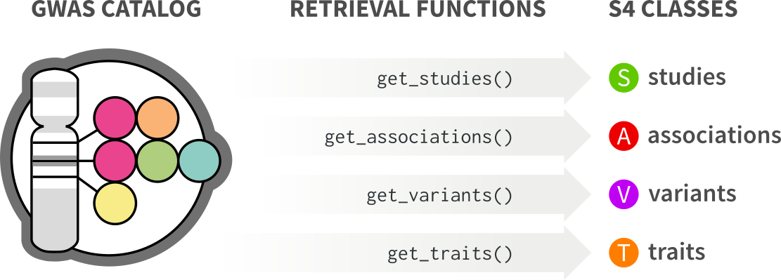



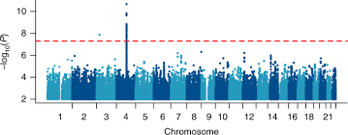

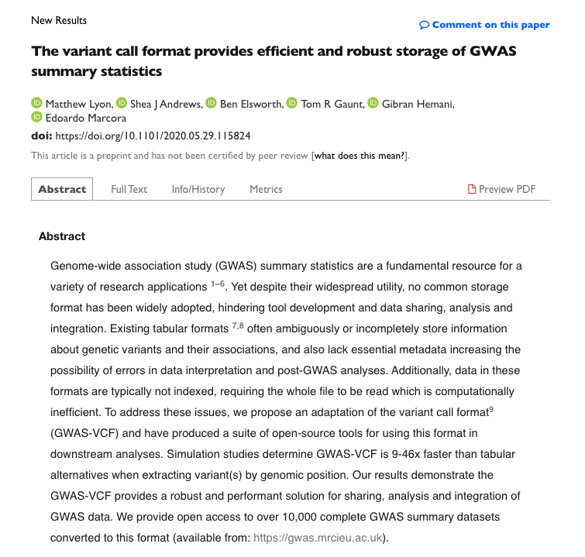
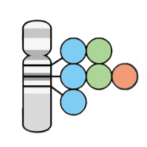

Abstracts and PDFs
PMIDs
Inclusion/Exclusion Criteria
STUDIES
Data Extraction
Tier Assignment
ASSOCIATIONS
Harmonization and Annotation
GENES
https://www.biorxiv.org/content/10.1101/2020.05.29.115824v1
PAPER
https://github.com/marcoralab/adsp_gvc_paper

Slide 2
Risk-associated variant(s)
Single variant test
Aggregate variant test
Region
Other
Statistical Association Tiers
Assoc-to-Gene Mapping Tiers
Candidate risk gene(s)

